Slide 1
CAST A COLD EYE
Allen Dulles’ interest in Indonesia (formerly Netherlands East Indies)
Greg Poulgrain
ypoulgrain@gmail.com
Federal Republic of West Papua
Zoom Book Launch, 19 September 2021

Slide 2
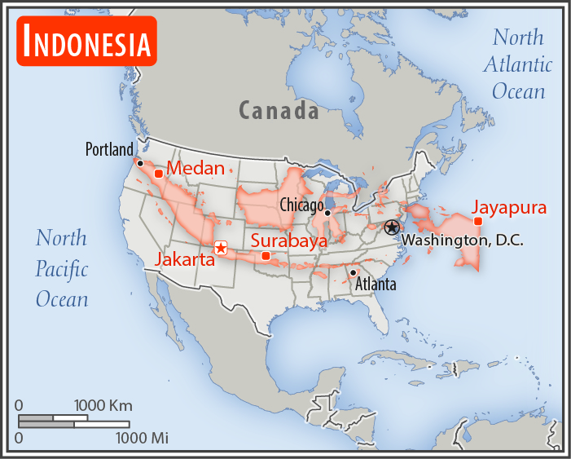
Indonesian Archipelago transposed onto a map of the USA. Portland (Oregon) is the equivalent location
of Sabang (North Sumatra).
Indonesia, from west to east as
the crow flies, is 5247 kilometres.

Slide 3
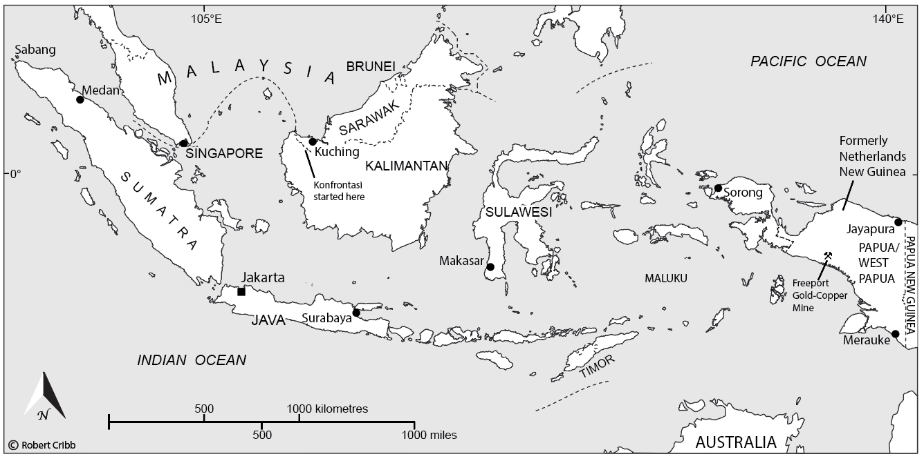
The east-west extent of Indonesia is 13% of the circumference of the earth … almost
one-seventh of the equator.
INDONESIA

Slide 4
Indonesian economy
is largest in Southeast
Asia and the 16th
largest in the world
Indonesia economy
is on track to be in
the world’s top
four in 2050
Allen Dulles first became interested in
the Indonesian archipelago in the 1920s.
Dulles was a lawyer linked with Rockefeller Oil, which in the 1920s was the biggest company in the world.

Slide 5
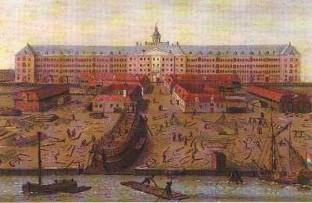
The VOC (Dutch East Indies Company, founded in 1602) used to be the biggest company in the world, as reflected in the size of
its headquarters

Slide 6
In the 1600s, the VOC became the richest company the world has ever seen …. with a current-equivalent
of US$7.9 trillion
Today’s top twenty companies combined are the equivalent
of the Dutch East India Company (VOC) in the 1600s.

Slide 7
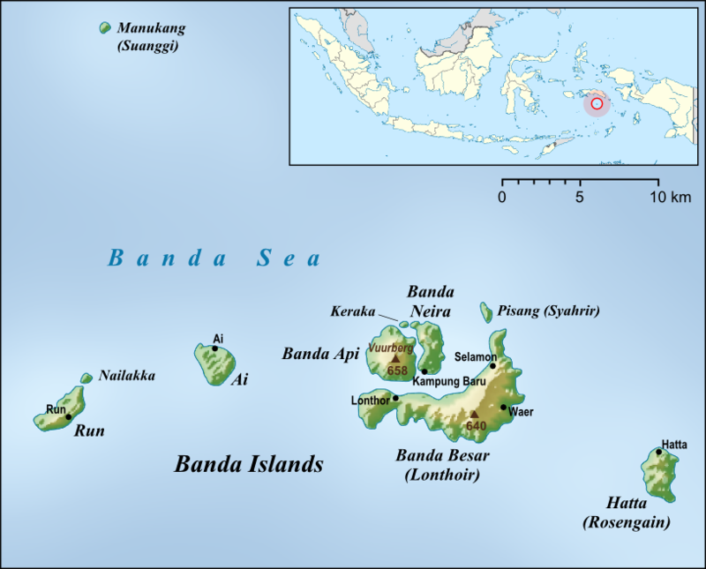
In 1667, the Dutch exchanged the island of Manhattan for the nutmeg island of Run (the last British outpost in the archipelago).

Slide 8
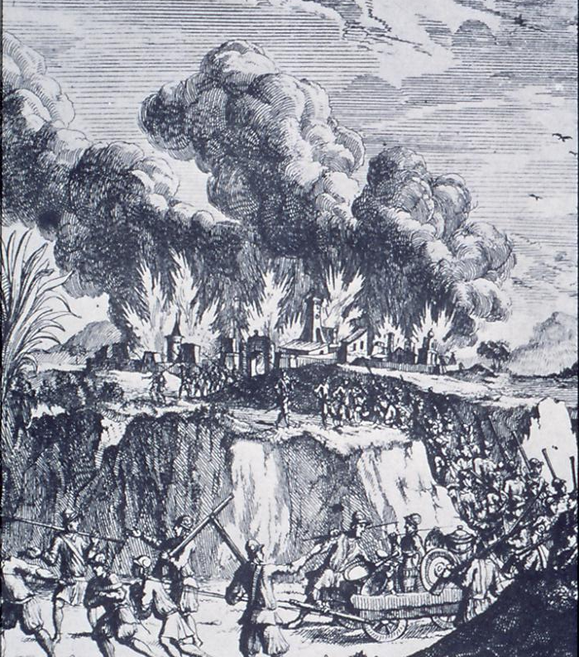
Dutch military power
occupied the Indies archipelago, increasing colonial control over the
next three centuries … … until mid-20th century
Invasion by the Japanese
Imperial Army
The Japanese aimed to claim New Guinea–east and west– and use its natural resources to make a NEW JAPAN.

Slide 9
History intervened …
After World War II Sukarno declared independence ….
and from the Netherlands
East Indies Indonesia was
born.
Allen Dulles from 1920s could see the Indies’ potential, but his focus was on Netherlands New Guinea (the same as Japan’s in 1940s).
Rockefeller had been trying to access Netherlands New Guinea since WW1.
JFK vs Allen Dulles : Battleground Indonesia begins with the company Dulles formed in 1935 for oil exploration in NNG.
This was a US-Dutch company with 60% controlled by Rockefeller interests.

Slide 10
In 1936 the world’s largest primary deposit of gold found in the
Netherlands New
Guinea highlands
Indonesia won its independence from Dutch colonial rule in 1949, but the Dutch retained the western half of New Guinea.
Only Allen Dulles and the Dutch political elite were aware of the gold and oil, not
the Dutch public, and not Indonesia…

Slide 11
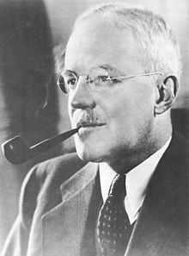
Starting in 1955, Allen Dulles began
plotting to assassinate President Sukarno.
Dulles was Director of Central Intelligence
in the 1950s under President Eisenhower and in 1961 under President JF Kennedy.

Slide 12
Rockefeller interests could not gain unrestricted access to the Eldorado of oil, gas, copper and gold in New Guinea until preparatory steps had been made, which were:

Slide 13
Dulles Indonesia Strategy
1. Oust the Dutch colonial power (1950 to 1962)
2. Curb Papuan independence (Hammarskjöld)
3. Sukarno was given control of West New Guinea in 1962
(but at the same time Dulles was arranging for military regime to replace him, by centralised army command in 1958 and by military coup in 1965-66.

Slide 14
The sovereignty dispute of the 1950s
Before WW2, Netherlands New Guinea did not have much Dutch rule: only 5% of the territory was under colonial administration.
After WW2, the more the Dutch colonised the territory, the louder the Indonesian call for the Dutch to leave.

Slide 15
Joseph Luns (Dutch foreign minister) faced one sovereignty dispute with Indonesia, and another with Rockefeller mining interests
LIE 1: The territory was worthless … it had lots of water and timber but no oil, gas, or minerals.
LIE 2: The disappearance of Michael Rockefeller meant that Papuans were incapable of modern government.

Slide 16
Dulles upgrades sovereignty dispute to Cold War crisis
In 1960, just before President Kennedy is inaugurated, General Nasution (head of Indonesian army) flies to Moscow for huge arms deal of ships and planes to oust the Dutch from West New Guinea.
President Kennedy wants to avoid being caught between Soviet Union support for Indonesia and US commitment to support Netherlands as NATO ally (North Atlantic Treaty Alliance). China also supported Indonesia.

Slide 17
Kennedy quietly
meets UN Sec-General Dag Hammarskjöld
28 APRIL 1961
Kennedy and Hammarskjöld meet in presidential suite of Waldorf Astoria Towers in New York.
Hammarskjöld will use the same ‘independence package’ (OPEX) for Papuan people that he has been implementing in Africa.
UN will intervene in the sovereignty dispute to grant independence for the Papuan people at
the 1961 UN General Assembly.

Slide 18
George Ivan Smith
I interviewed Hammarskjöld’s assistant, George Ivan Smith, in the UK in 1982.
He explained Hammarskjöld’s plan to
solve the sovereignty dispute which
had become a Cold War crisis.
He said the New Guinea crisis was more important to Hammarskjöld than anything else. However, before the 1961 General Assembly Hammarskjöld had to visit the Congo where a problem had erupted.

Slide 19
Dulles bad record in the Congo
Hammarskjöld went to the Congo in September 1961 because of unrest after
Congo’s first president Patrice Lumumba was killed.
The US Senate in 1975, under Senator Church, investigated the death of Lumumba and
found Allen Dulles had primary responsibility for his death.
Allen Dulles was also involved in the death of Dag Hammarskjöld, according to
documents recovered by Bishop Tutu.
UN investigation into the death of Hammarskjöld has not yet taken into account
Allen Dulles’ additional motive for wanting Hammarskjöld removed.
JFK vs Allen Dulles: Battleground Indonesia shows Dulles’ motive in Southeast Asia
far exceeds anything else …. the Cold War struggle there mirrored the clash which
occurred in Cuba in 1961 – even though kept out of the headlines.

Slide 20
JFK becomes involved in sovereignty
dispute
After Hammarskjöld was killed President Kennedy was forced to intervene in the sovereignty dispute between Indonesia and the Netherlands, which resulted in the New York Agreement (15 August 1962)

Slide 21
1 MAY 1963
West New Guinea transferred from Netherlands to Indonesia. Sukarno arrives in Hollandia (Jayapura) on ‘Irian’, a former Soviet warship, triumphant after ousting Dutch colonial power.
NOVEMBER 1963
Kennedy’s assassination stopped his visit to Jakarta to restart massive US-Aid program
to ‘bring Indonesia on side’ in the Cold War.
1 OCTOBER 1965
30 months after Sukarno’s triumphant entry into Hollandia, six military-generals
were killed in Jakarta, and Suharto took control of the Indonesia army.

